Slide 1
CAI – Introduction to Git and Gitlab
A distributed version-control system for tracking changes in files
Notes:
Welcome everyone to our introduction into git and the CAI-gitlab sever. Before we get started, we would like to acknowledge the traditional owners of the land on which we are situated on, which for us here in St Lucia are the Tur-a-bul/Yug-er-a people.

Slide 2
Thank you
Alan for providing and setting up the gitlab server + managing backups
Aswin for installing and configuring gitlab
Lars Kasper for discussions and material
Paula for organising the event
Notes:
Steffen

Slide 3
Foreword
Our teaching approach today (explained with bikes)
Notes:
Steffen

Slide 4
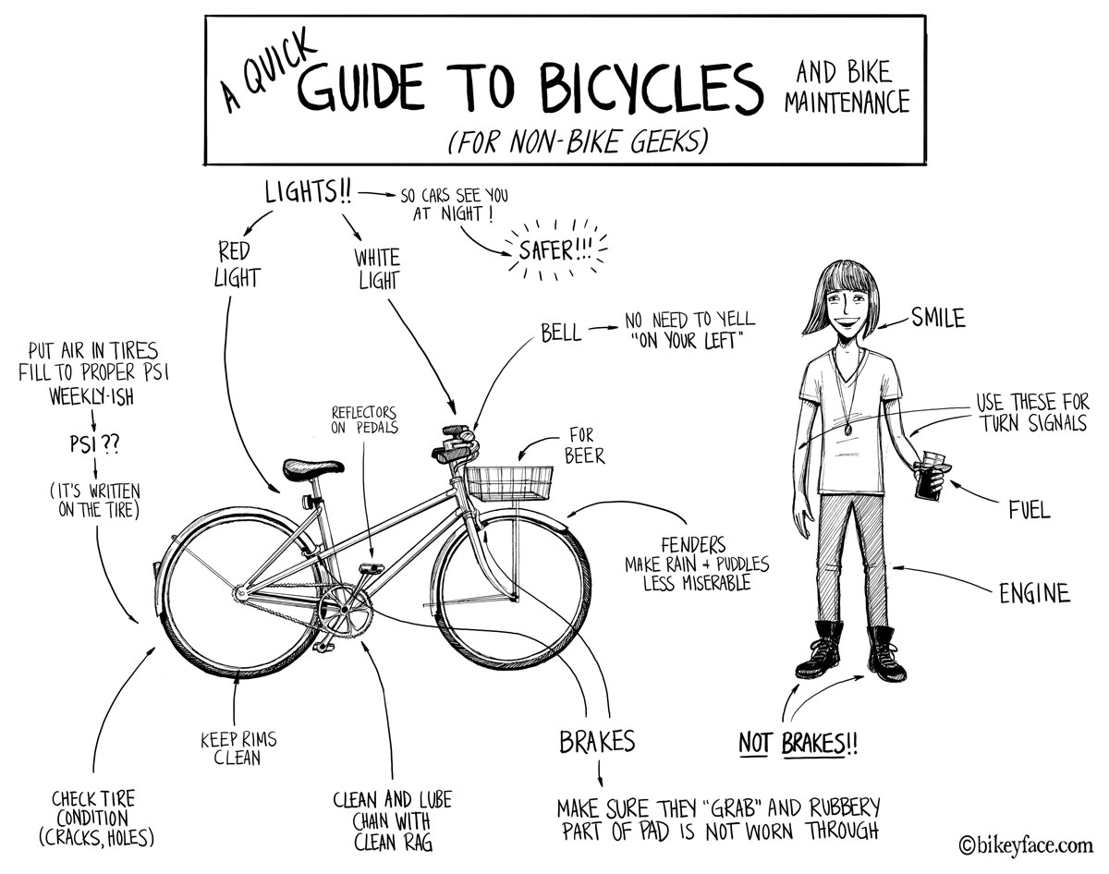
Most git tutorials you find online:
GIT
https://bostonbiker.org/tag/comic/

Slide 5


The git tutorial we are attempting:
Steffen
Saskia
http://www.cartoonclipartfree.info/Cliparts_Free/Fussball_Free/Clipart-Free-Gif-24.gif
https://clipground.com/images/clipart-of-a-little-girl-riding-a-bike-12.jpg

Slide 6
Aims / Use Cases
I found some code on gitlab/github and want to use it (and keep it up to date)
My student and I want version control for their PhD project
How to create a new project from scratch
How to create a new project from existing code (but no repository)
Someone wants to join the project
Adding a user
How to use git on the cluster/workstations/CVL
Bonus Track
Collaboration with others via Forking and pull requests

Slide 7
Scenario I
I found some code on gitlab.com/github.com and want to use it (and keep it up to date)

Slide 8
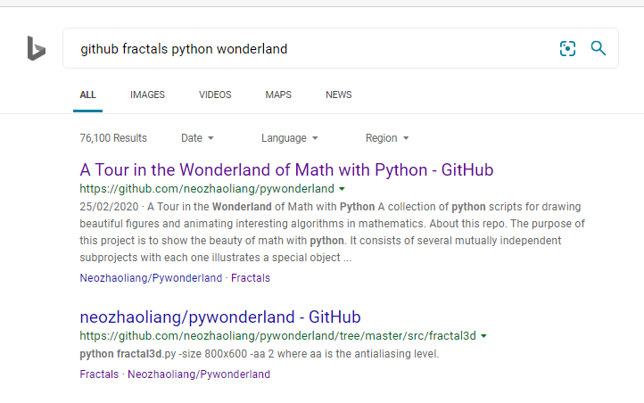
Example: Fractals in python

Slide 9
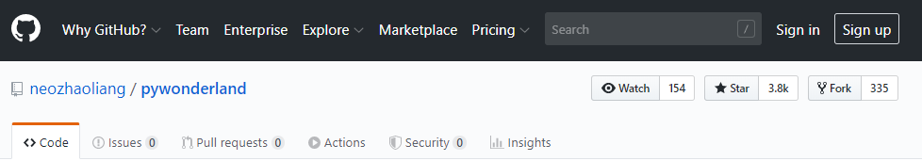
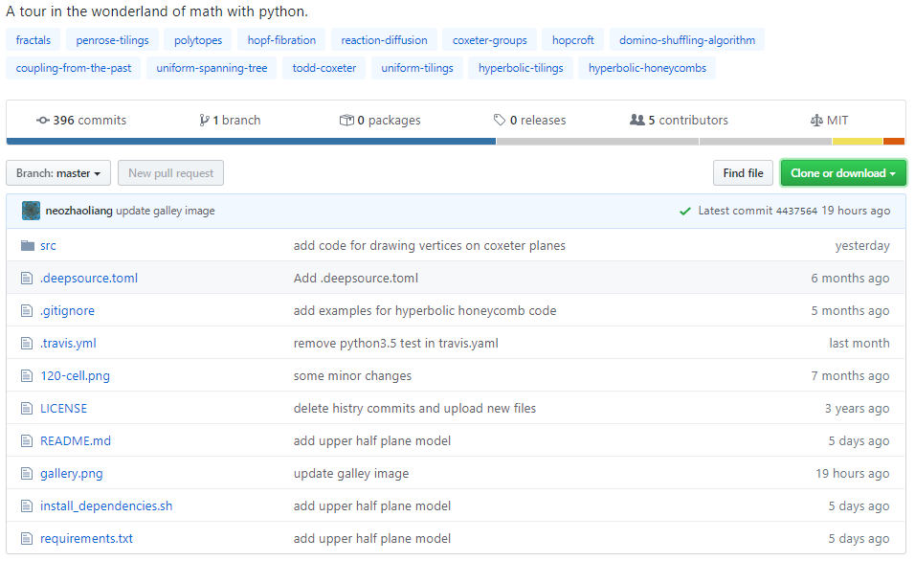

Slide 10
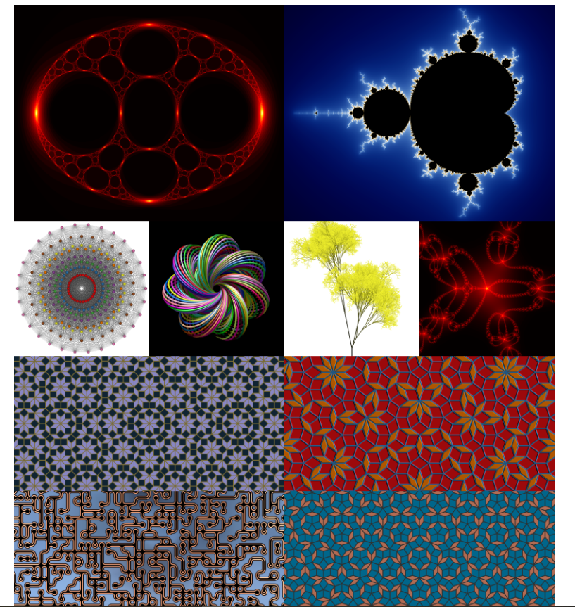

pywonderland
Notes:
Before moving further: What actually is a repository?

Slide 11
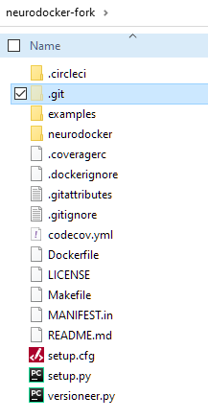
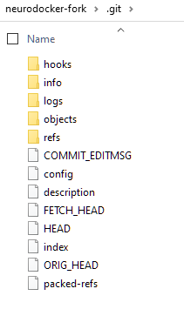
Repository
Virtual storage of project files including history
Notes:
Steffen:

Slide 12
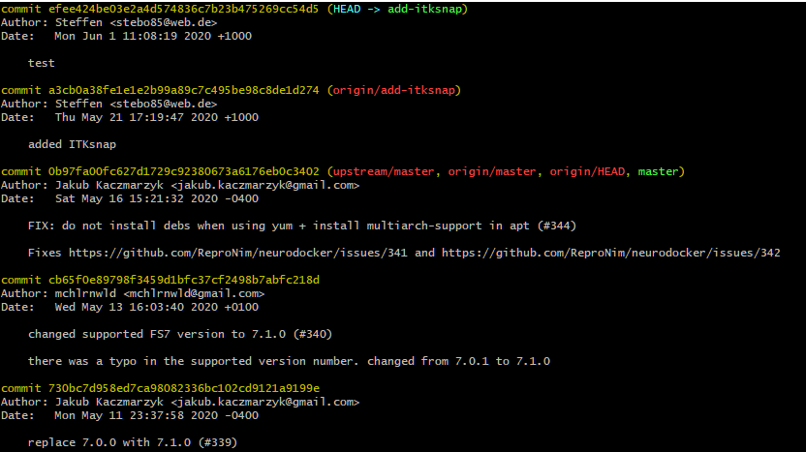
Repository
Virtual storage of project files including history
Notes:
Steffen:

Slide 13
Intermezzo I
How to install git
(and create a nice development environment for Python)

Slide 14



Ingredients for a Python IDE
Integrated Development Environment: Visual Studio Code
Python via miniconda
Git
from the internet
from the internet
(don’t use anaconda from the software centre – it is too old!)
from the Software Centre
Note: Most IDEs (pycharm, matlab, RStudio) already have a git interface

Slide 15
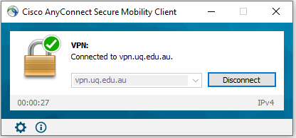
Connect VPN

Slide 16
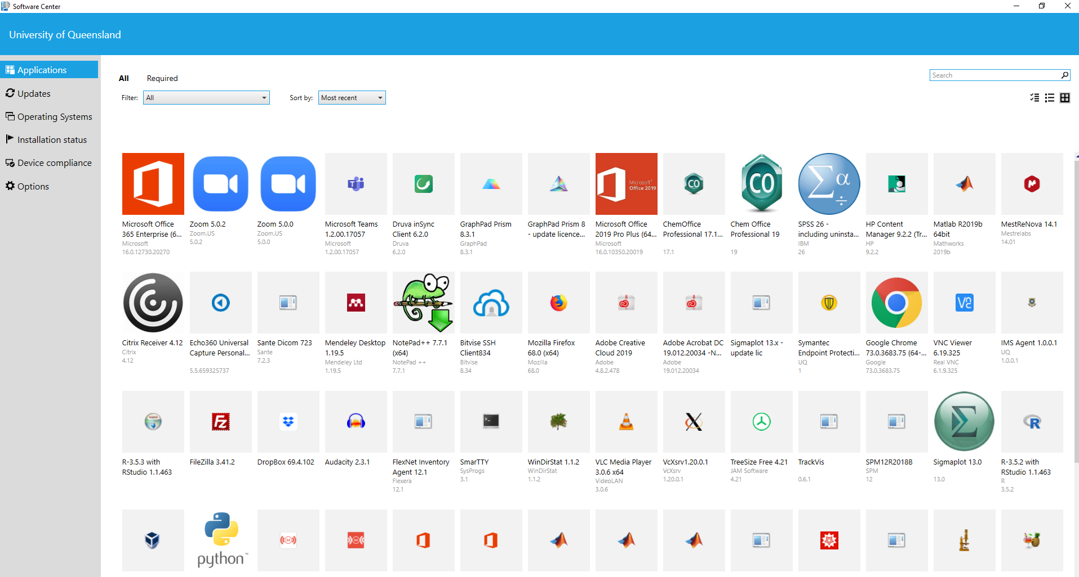
Open Software Centre

Slide 17
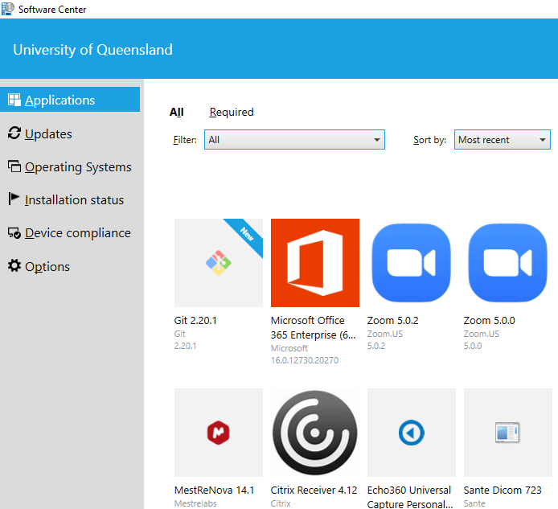
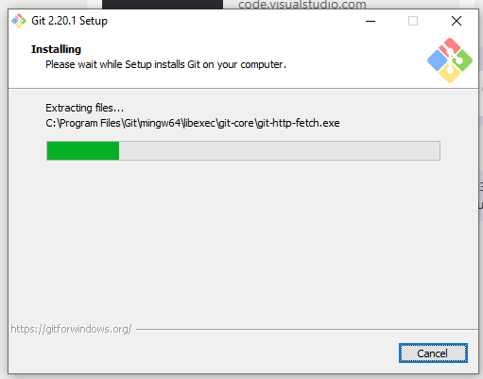
Install git
This may fail repeatedly – keep trying!

Slide 18
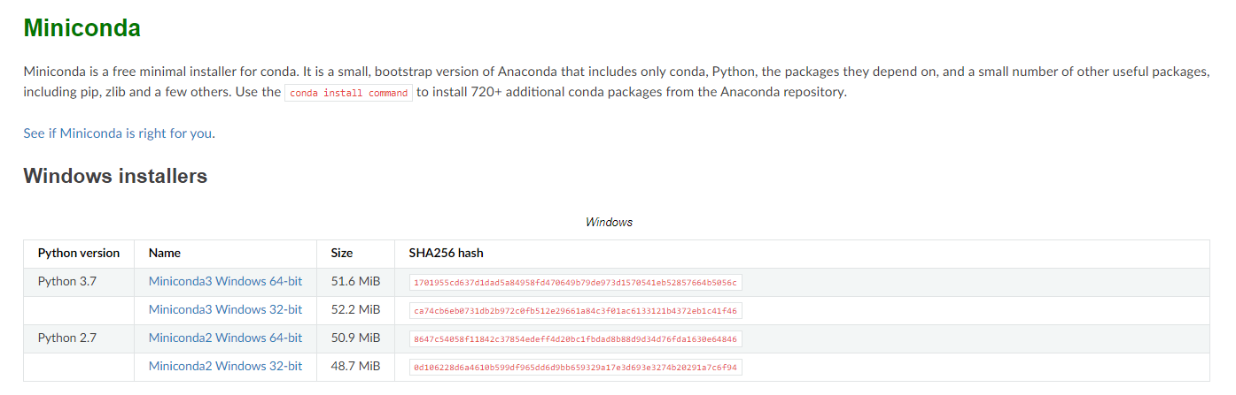
Install miniconda

Slide 19
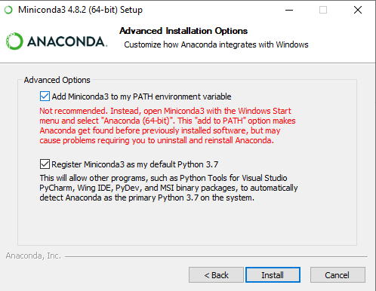
Add to system path

Slide 20
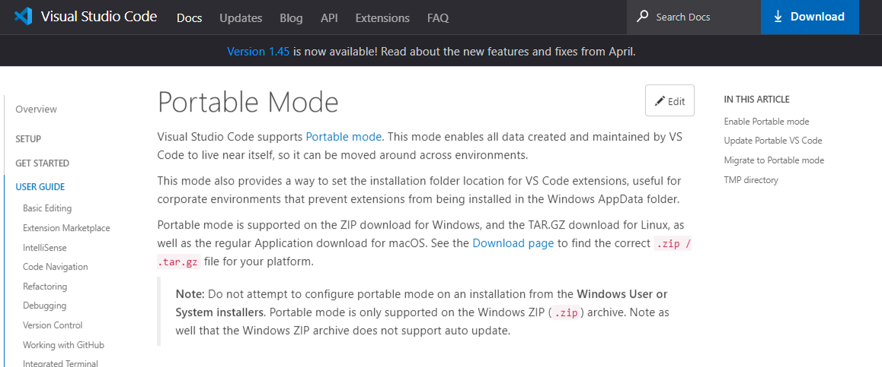
Install Visual Studio Code (portable version)
https://code.visualstudio.com/docs/editor/portable

Slide 21
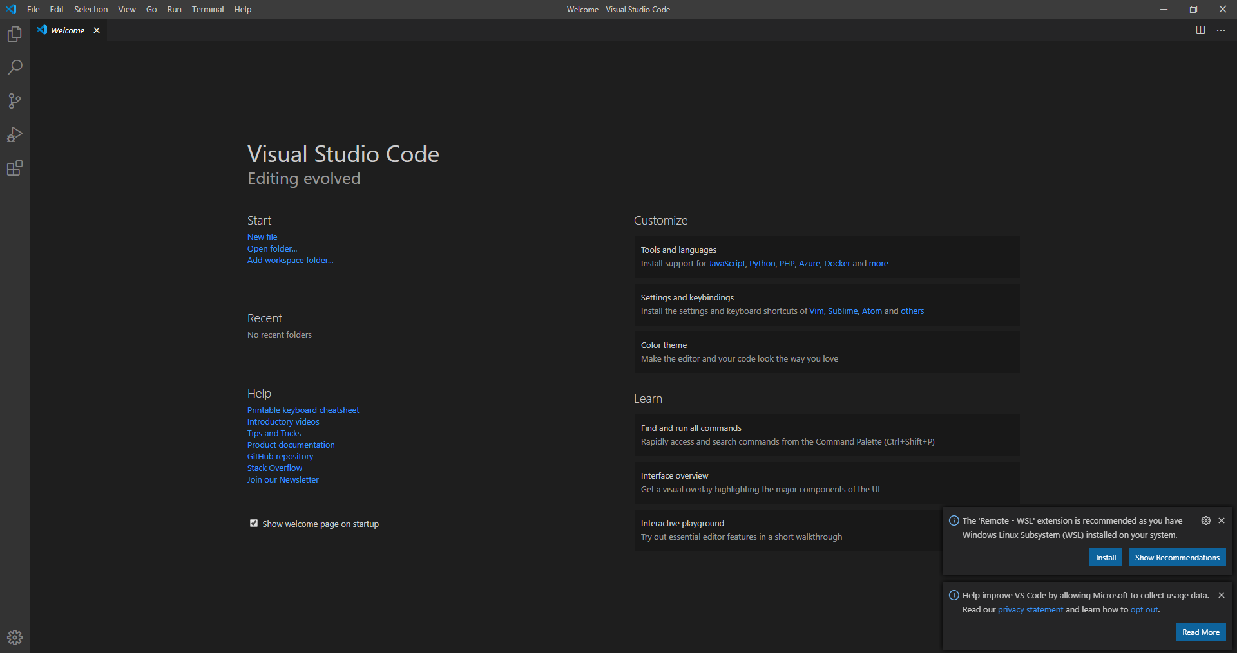
Open Visual Studio Code

Slide 22
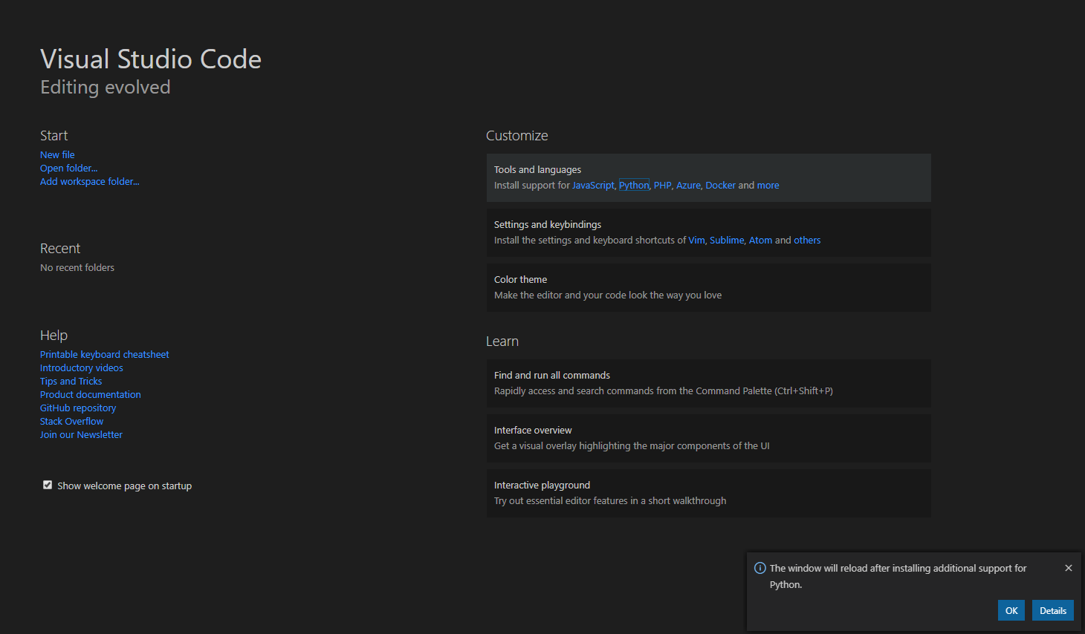
Enable Python Connection

Slide 23
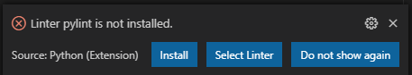
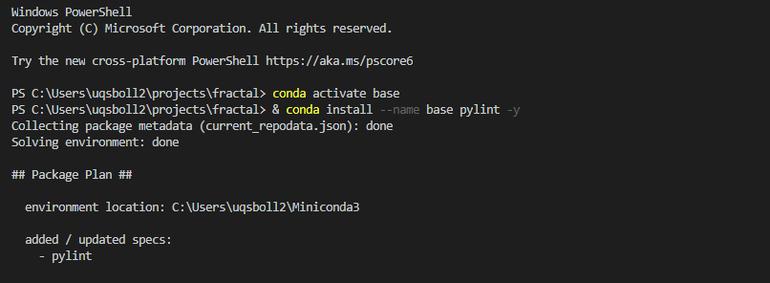
Add libraries

Slide 24
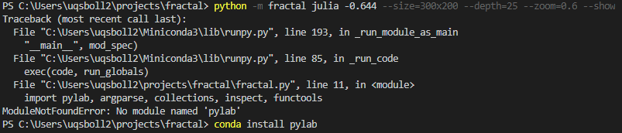
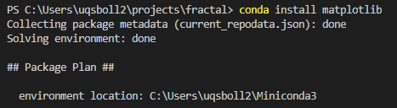
Add more libraries
Run program
Missing package
Try to get it (failed)
After some googling: pylab is part of matplotlib
Install matplotlib via conda

Slide 25
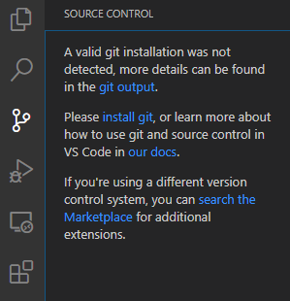
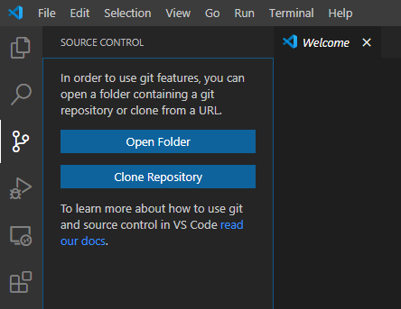
Using git in Visual Studio Code
Visual Studio Code will tell you if you forgot to install git
mri.sbollmann.net
Notes:
So, do I want to open a folder or clone a repository?

Slide 26
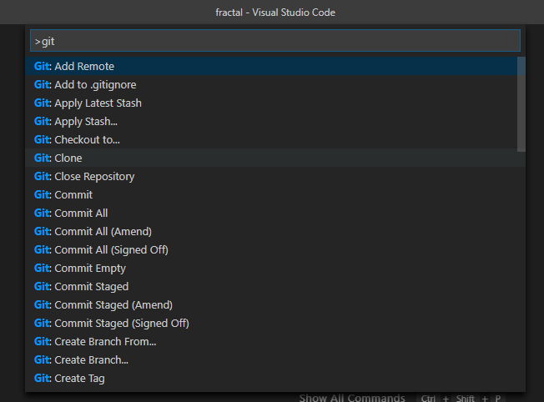
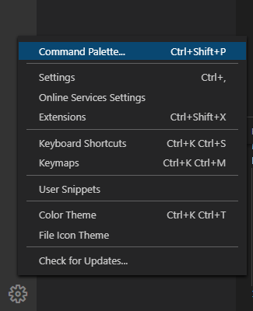
Git Clone via command palette

Slide 27
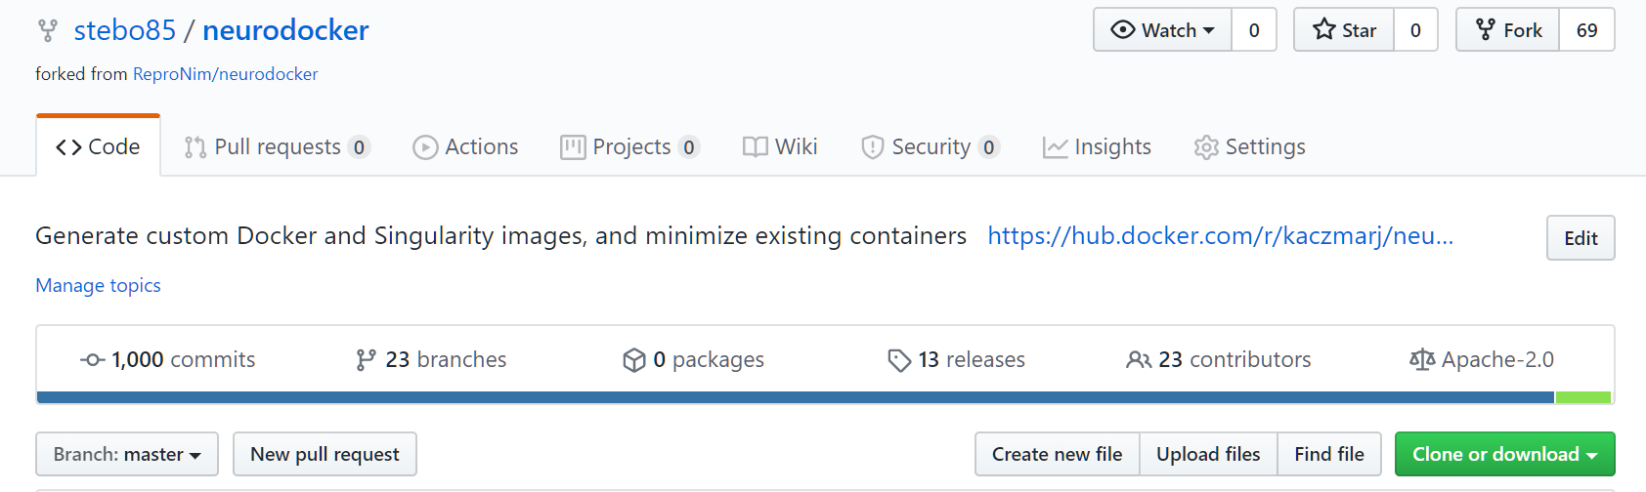
Clone Repository
https://github.com/stebo85/neurodocker
CLONE
make a copy of a repository from a central server to your own computer (for the first time)
C:\Users\uqsbollm\code\neurodocker-fork
Notes:
Steffen

Slide 28
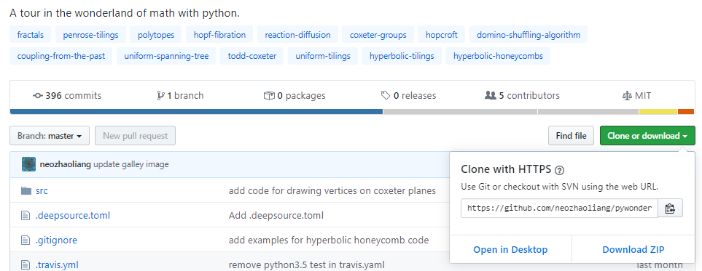
Repository URL
Klick
Notes:
Steffen comment on ssh vs https

Slide 29
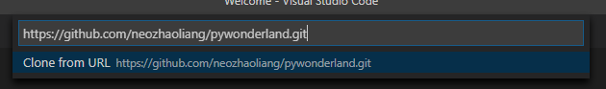
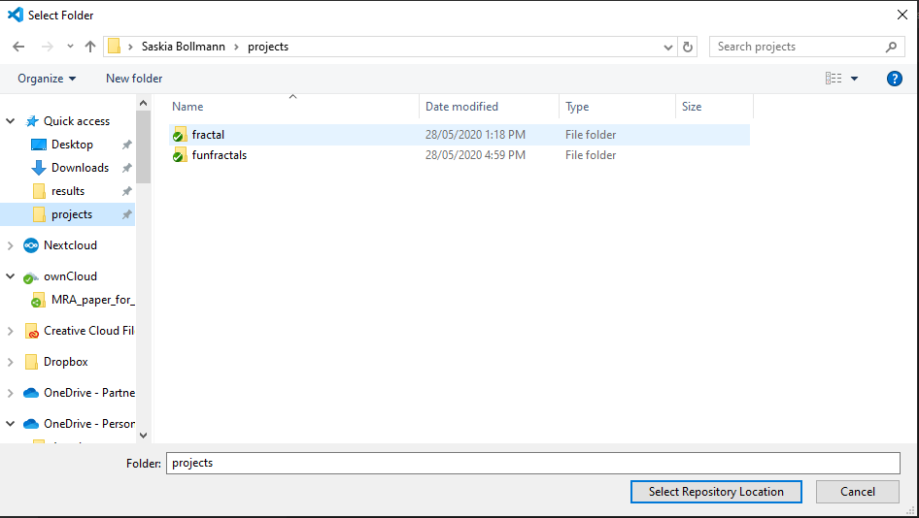
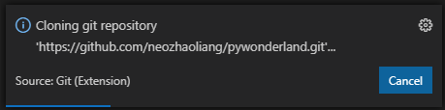
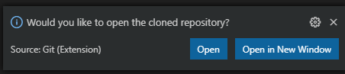
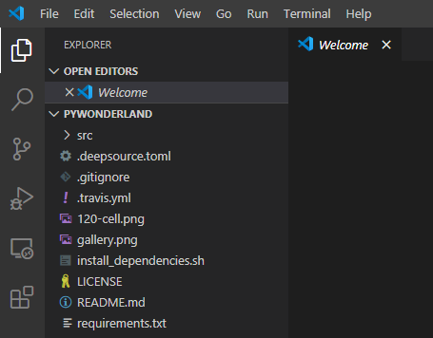

Slide 30
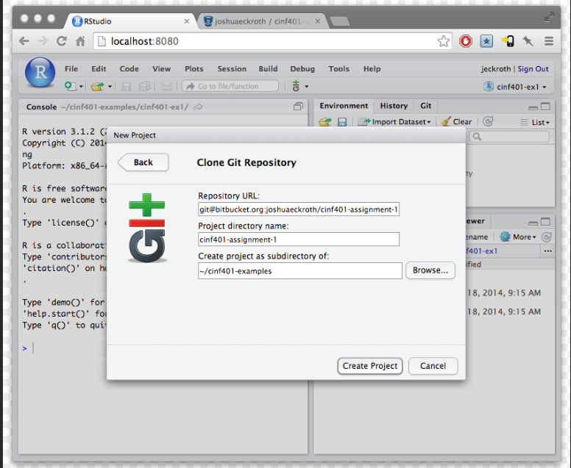
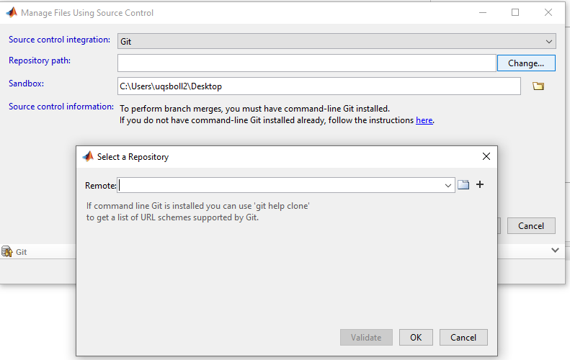
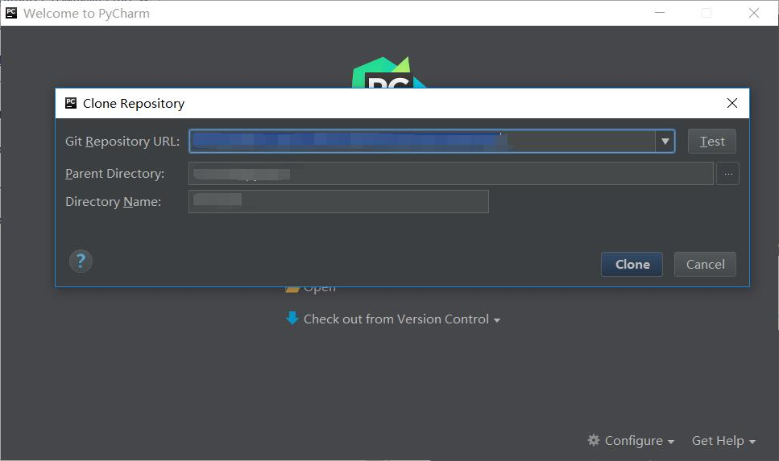
Git in other IDEs

Slide 31
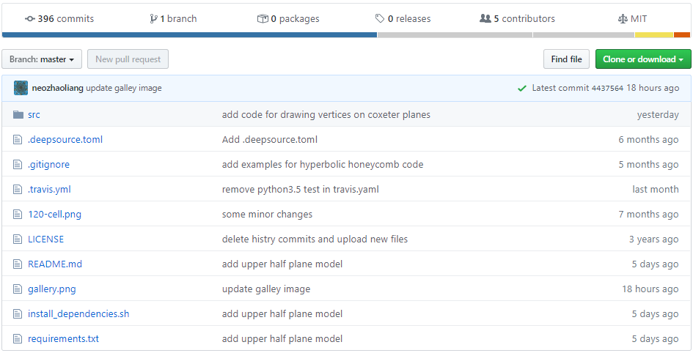
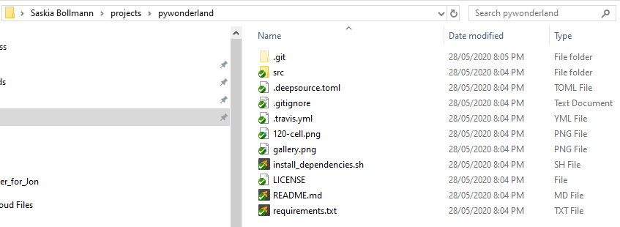
Local Repository
Remote
Notes:
Sometimes I get confused, so what’s the difference between a remote and origin?

Slide 32
Remote
Remote: Origin
https://github.com/stebo85/neurodocker
Clone
Definition: A repository stored on another computer
Origin = the name for the central remote repository
Local
C:\Users\uqsbollm\code\neurodocker-fork
Notes:
Steffen

Slide 33
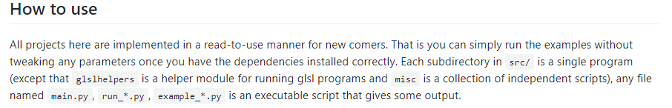
Run the new code

Slide 34
Intermezzo II
Adding packages using conda

Slide 35
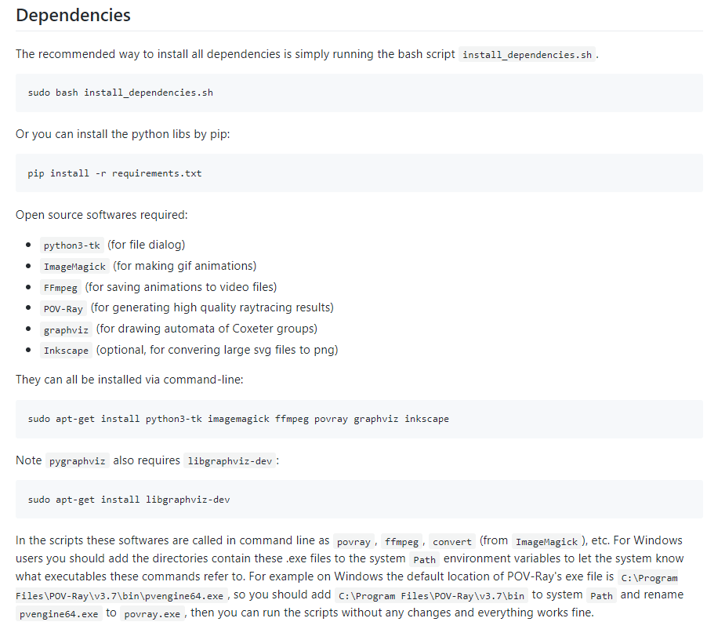

Slide 36
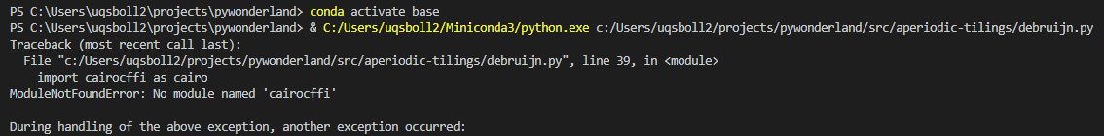
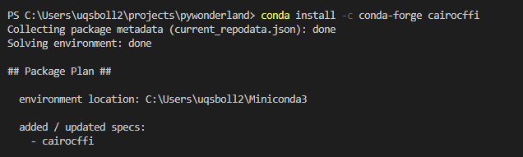
Adding cairocffi only

Slide 37
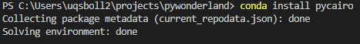
Install all requirements

Slide 38
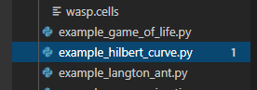



Generating fractals

Slide 39
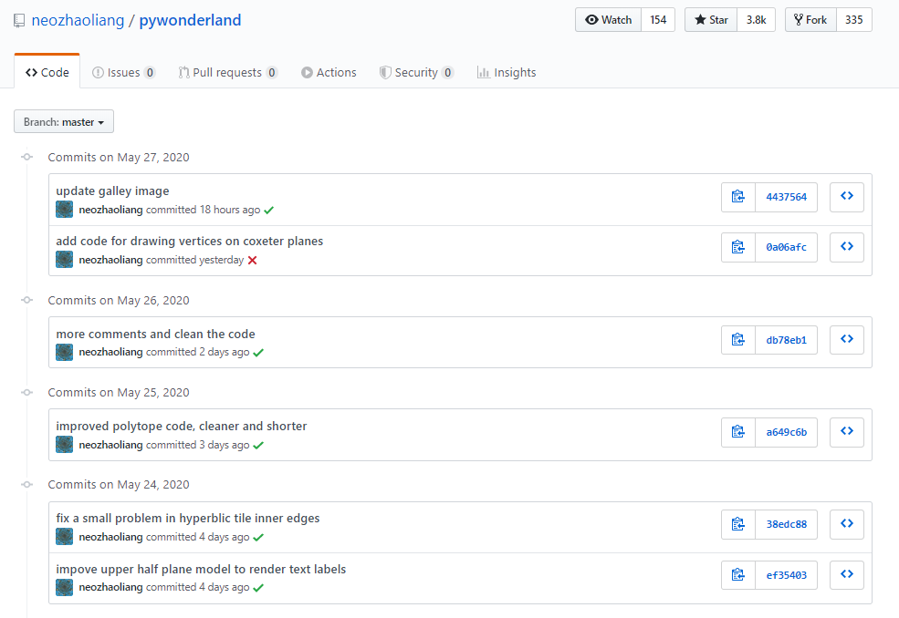

Slide 40
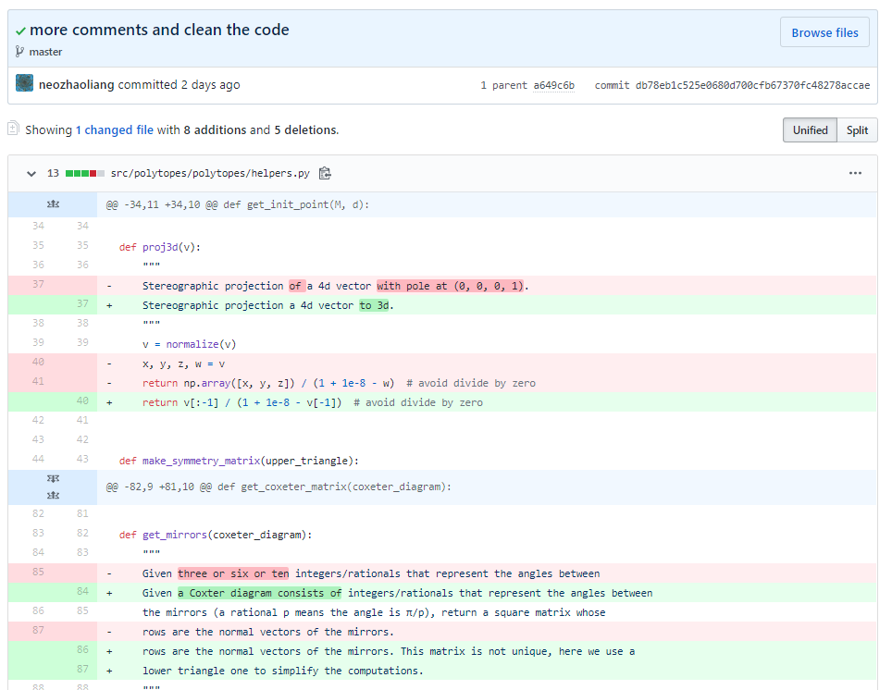

Slide 41
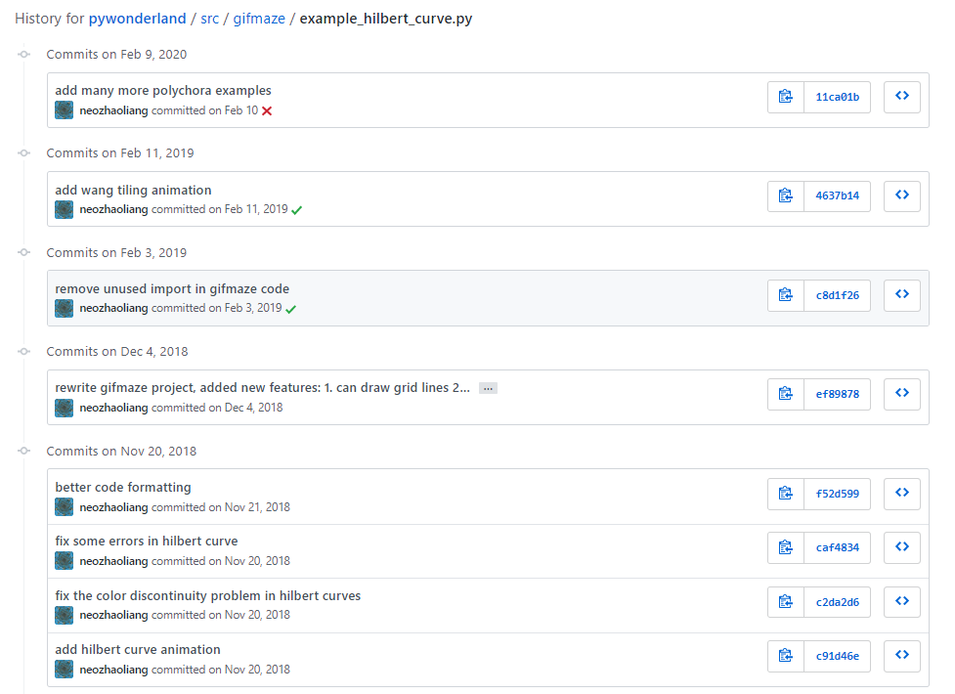
Notes:
The history of a repository is organized in commits. So what exactly is a commit?

Slide 42
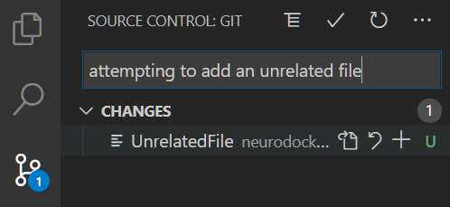
What is a “Commit”?
Committing a change means to create a snapshot of the project's current status. Commit often! Assign a clear message of your intention.

Slide 43
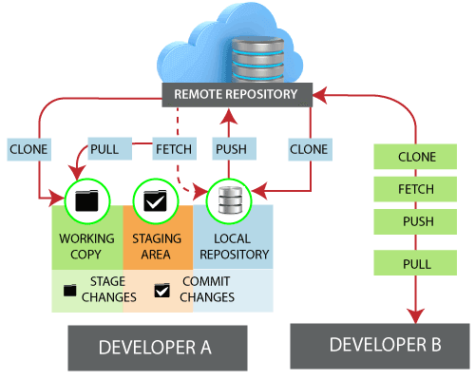
Summary
Repository
Readme
Commits
History
Remote vs Local
Git commands
Clone
User
https://www.javatpoint.com/git-remote

Slide 44
Scenario II
My student and I want version control for their PhD project
a) How to create a new project from scratch

Slide 45

Go to cai-gitlab.cai.uq.edu.au
Behind UQ firewall – code is protected!

Slide 46
Connect VPN

Slide 47
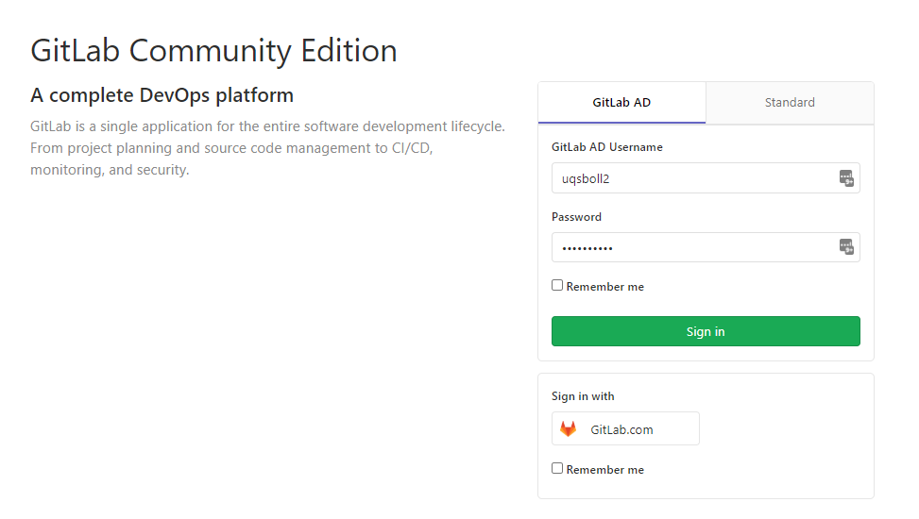
Go to cai-gitlab.cai.uq.edu.au
Login with UQ credentials

Slide 48
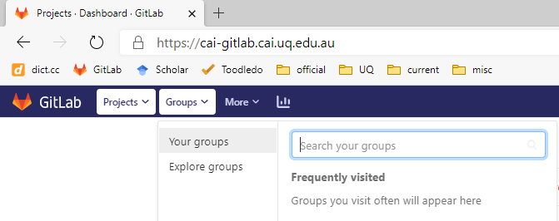
Go to groups

Slide 49

Go to groups

Slide 50

Choose your sub-project & create new project

Slide 51


Slide 52


Slide 53


Starting a new git repository

Slide 54


Global config

Slide 55


Creating new repository
1
1

Slide 56
Intermezzo III
Creating and adding SSH keys to gitlab

Slide 57


Creating new ssh key
https://help.github.com/en/github/authenticating-to-github/generating-a-new-ssh-key-and-adding-it-to-the-ssh-agent

Slide 58


Add public(!) key to gitlab

Slide 59




Creating new repository
1
2
3

Slide 60





Creating new repository
4
5
6

Slide 61



Slide 62


The truth – and only the truth

Slide 63




How history evolves
Notes:
Why do I always have to commit and then push? Why is it not just one thing?

Slide 64
Commit and Push
Remote 1: Origin
https://github.com/stebo85/neurodocker
Clone
Commit = recording the status locally
Push = uploading all history to a Remote
Push
Commit
C:\Users\uqsbollm\code\neurodocker-fork
Local
Notes:
Steffen

Slide 65


But nothing is ever truly lost

Slide 66


But nothing is ever truly lost

Slide 67



Fun fractals in visual studio code

Slide 68



Staging Area
Changes in Folder
Staging Area (files to be used for the next commit)
Repository
Notes:
Steffen

Slide 69

Fun fractals in visual studio code

Slide 70
Summary
Staging Area and Working Copy
Git commands
git status
git commit –am “Hello”
git push
https://www.javatpoint.com/git-remote

Slide 71

Making changes online

Slide 72


git fetch vs git pull
Notes:
Steffen

Slide 73
Summary
Git commands
git fetch = update a local repository to the state of a remote
git pull = git fetch + merge → incorporate changes from a remote repository into the current branch
https://www.javatpoint.com/git-remote

Slide 74
Scenario II
My student and I want version control for their PhD project
b) How to create a new project from existing code (but no repository)

Slide 75
Follow these steps

Slide 76

No big files! < 5MB
gitlab -> advanced topic: Continuous Integration = running tests
RDM / Git Annex + datalad
zotero
osf.io

Slide 77
Scenario III
Someone wants to join the project
a) Adding a user

Slide 78

Adding a member

Slide 79
Scenario III
Someone wants to join the project
b) How to use git on the cluster/workstations/CVL

Slide 80


Git on cluster/workstations/CVL

Slide 81

Branches are great for testing things quickly

Slide 82

Branches are great for testing things quickly

Slide 83

... and when successful can be merged ☺

Slide 84
Bonus Track
I want to collaborate with multiple people

Slide 85
Collaboration
https://github.com/ReproNim/neurodocker
Remote 2: Upstream
Fork
Remote 1: Origin
Pull request
https://github.com/stebo85/neurodocker
Clone
Definition: Remotes are Repositories stored on other computers – there can be multiple remotes!
Common names:
Origin: The “central” repo of the current project
Upstream: The central repo the current project is forked from
Push
Pull
Local
C:\Users\uqsbollm\code\neurodocker-fork
Notes:
Steffen

Slide 86

Thank you!
Please fill out feedback form:
http://tiny.cc/accsfeedback
Please try out what you learned and post questions and problems in Microsoft teams, so everyone can learn ☺
https://i.pinimg.com/originals/69/c0/0f/69c00f325edfbd05913f13603d5741ea.jpg

